Slide 1


Computer Network Basics of Network Transmission Media & Types Guided Media: Twisted Pair Cable, Unshielded Twisted Pair, Coaxial Cable, Optical Fibers Unguided Media: Radio waves, Microwaves, Infrared
Lecture #2
Week#1
Data Communications and Networking, Fourth Edition, Behrouz A. Forouzan

Slide 2
Transmission Media & Types
In network communications, a transmission medium is a physical connection or an interface between the transmitter and the receiver.
A transmission medium is the path through which data travels from one device to another.
It acts like a bridge between the transmitter and the receiver.
What is a Transmitter?
The transmitter is the device that sends data
Mobile phone sending a message
What is a Receiver?
The receiver is the device that receives data.
Mobile phone receiving a message
There are two major categories of transmission media, namely
Guided Media (Wired Communication)
Unguided Media (Wireless Communication)

Slide 3
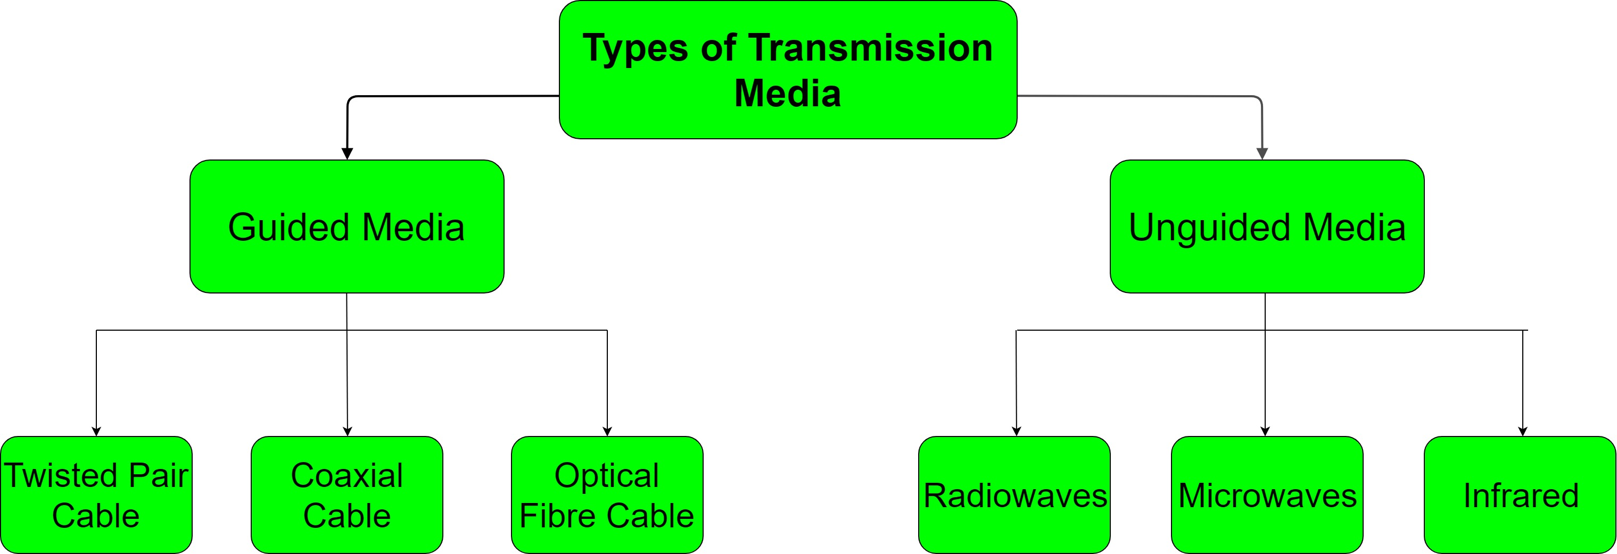

Slide 4
Guided Media
It is also referred to as Wired or Bounded transmission media.
Signals being transmitted are directed and confined in a narrow pathway by using physical links.
Features:
High Speed
Secure
Used for comparatively shorter distances

Slide 5
Twisted Pair Cable
It consists of 2 separately insulated conductor wires wound about each other.
Generally, several such pairs are bundled together in a protective sheath.
They are the most widely used Transmission Media.
Twisted Pair is of two types:
Unshielded Twisted Pair (UTP)
Shielded Twisted Pair (STP)
Real-life examples:
Landline telephone wires
Ethernet cables in homes/offices
Computer lab networking
Common in LANs (Local Area Networks).

Slide 6
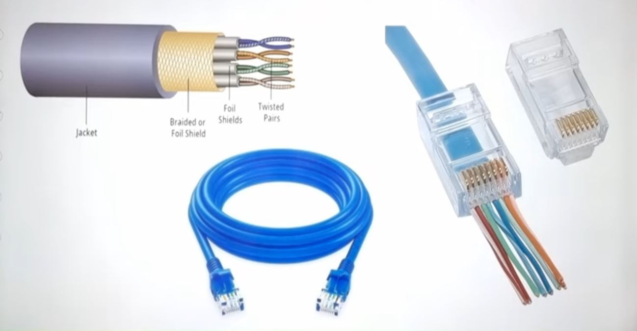
Twisted Pair Cable

Slide 7
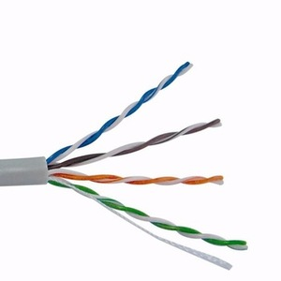
Unshielded Twisted Pair (UTP)
UTP is a type of cable made of pairs of copper wires twisted together. UTP is a low-cost twisted pair cable without shielding, commonly used for short-distance data transmission in computer networks.
The twisting helps reduce interference, even though there is no metal shield.
Data travels as through the copper wires.
It is used for telephonic applications.
Advantages:
Least expensive
Easy to install
High speed capacity
Lower capacity and performance in comparison to STP
Short distance transmission

Slide 8
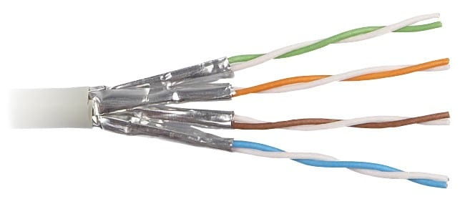
Shielded Twisted Pair (STP)
STP is a twisted pair cable in which the copper wires are covered with an extra metallic shield. This shield protects the signals from external interference and noise.
It is used in fast-data-rate Ethernet and in voice and data channels of telephone lines.
Advantages:
Better performance at a higher data rate in comparison to UTP
Comparitively faster
Comparitively difficult to install and manufacture
More expensive
Where is it used?
Industrial areas
Banks networks

Slide 9
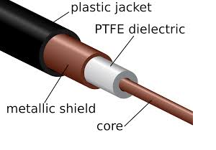
Coaxial Cable
One central copper wire (carries data)
Insulation layer
Metal shield (protects from noise)
Outer plastic cover
Because of the shield, it has better protection from noise than twisted pair cables.
It has an outer plastic covering containing 2 parallel conductors each having a separate insulated protection cover.
Example:
Cable TVs widely use Coaxial cables.
Advantages:
High Bandwidth
Better noise Immunity
Easy to install and expand
Inexpensive
Disadvantages: Single cable failure can disrupt the entire network
Real-life examples:
Cable TV connections
CCTV camera wiring
Better protection from noise than twisted pair.

Slide 10
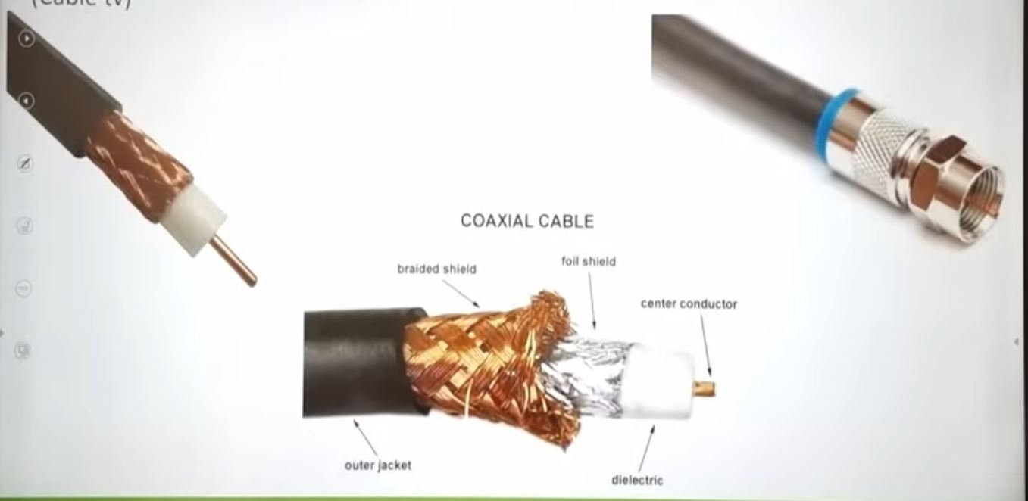
Coaxial Cable

Slide 11
Optical Fibers
It uses the concept of reflection of light through a core made up of glass or plastic.
The core is surrounded by a less dense glass or plastic covering called the cladding.
It is used for transmission of large volumes of data.
The WDM (Wavelength Division Multiplexer) supports two modes, namely unidirectional and bidirectional mode.
Structure:
Core → carries light (glass or plastic)
Cladding → less dense layer around the core
Outer jacket → protects the fiber
The cladding keeps the light inside the core by reflection
Real-life examples:
Fiber internet (PTCL)
Hospital and university high-speed networks
Best for long distance & high-speed data.

Slide 12
Unguided Media
It is also referred to as Wireless or Unbounded transmission media.No physical medium is required for the transmission of electromagnetic signals.
Features:
Signal is broadcasted through air
Used for larger distances
There are 3 major types of Unguided Media
Radio waves
Microwaves
Infrared

Slide 13
Radiowaves
Radio waves are wireless signals that carry data through air. They do not need wires or cables.
How do radio waves work?
A transmitter sends signals as radio waves
The waves travel through air
A receiver catches those waves
Like talking and listening, but without wires.
Real-life examples:
FM radio
Wi-Fi
Bluetooth

Slide 14
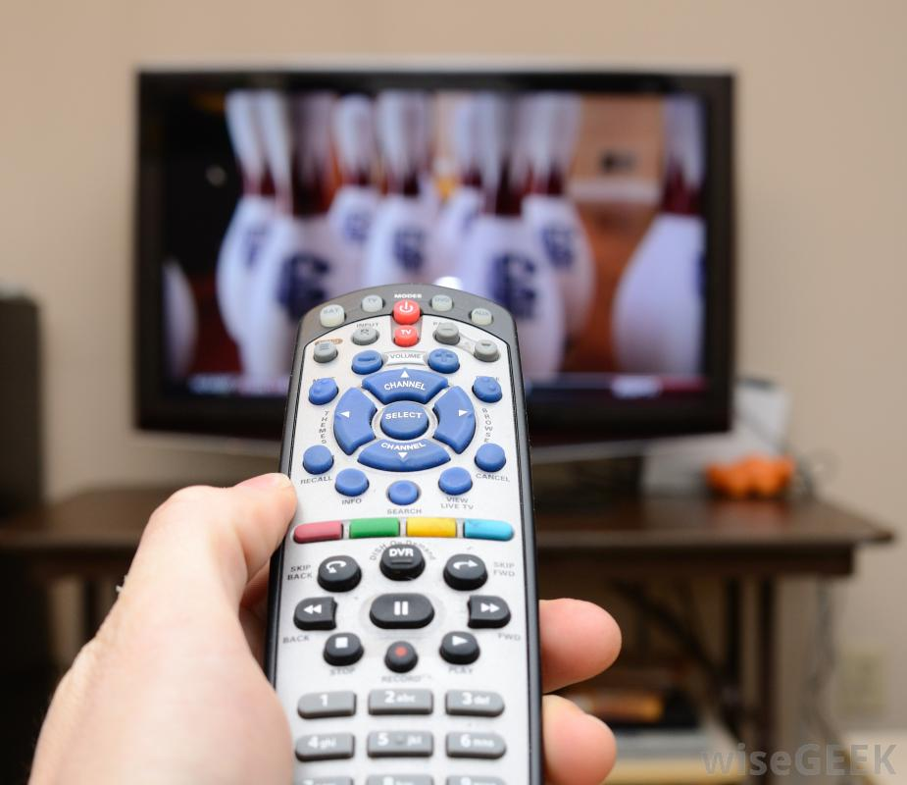
Infrared
Infrared waves are used for very short distance communication.
How does infrared work?
A transmitter sends infrared signals
The signal travels in a straight line
A receiver detects the signal
It usually needs line of sight (no walls in between).
It is used in TV remotes, wireless mouse, keyboard etc.
Real-life examples:
TV remote control
Wireless headphones
File transfer between phones

Slide 15
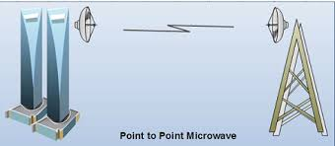
Microwaves
It is a line of sight transmission i.e. the sending and receiving antennas need to be properly aligned with each other.
The distance covered by the signal is directly proportional to the height of the antenna.
These are majorly used for mobile phone communication and television distribution.
Real-life examples:
Mobile Phoone Towers
Satellite communication
Microwave ovens (same type of waves)
Used for long-distance wireless links.

Slide 16
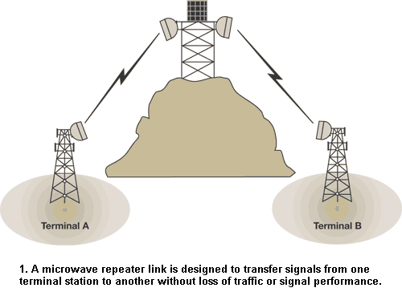
Microwave

Slide 17
THANK YOU
You can Find me:
mehakrana.CS@tuf.edu.pk

